Slide 1

VoteME - Online Voting System
Akshatha r (1nh15mca06)
Lalit Kumar (1nh15mca38)

Slide 2
Index
Introduction
H/W and S/W Requirement
Module Description
Screen Shots

Slide 3
Introduction
VoteMe (e-Polling System) is developed with the aim of creating a platform which will make voting process easier, allowing citizens above 18 years of age to cast their vote online.
This web-based project is implemented in ASP.NET with C# using MySQL database as back-end and Microsoft Visual Studio. Net as front-end tool.
VoteMe (e-Polling System) creates and handles details regarding polling and election which will enable all citizens to cast their vote via a web-based platform.
Database consisting of records and details of the citizens and candidates who are eligible to vote are maintained by the system.

Slide 4
H/w and s/w requirement
Software Specification:
Operating system : Windows XP or Mac OS
Coding Language : ASP.Net with C#
Data Base : MySQL
Hardware Specification:
Ram : 1 GB
Hard Disk : 100 GB

Slide 5
Module Description
Election Officer : The admin can create and manage a Polling Event.
User module : The user can login using the ADHAR NO and Mobile NO. The all Voting events will be displayed with the description so user can vote there easily.

Slide 6
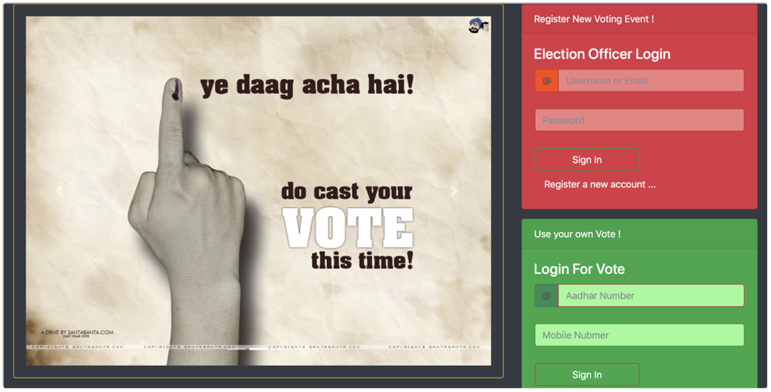
screen shots - 1. home page

Slide 7
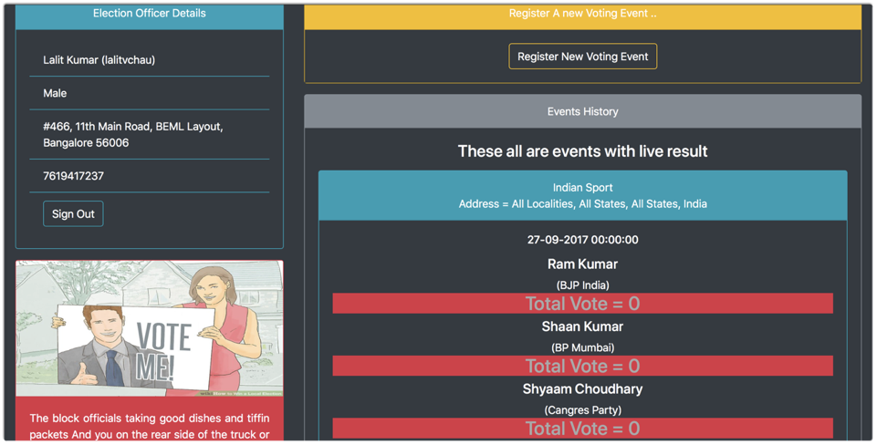
screen shots
2. ELEction Officer Page

Slide 8
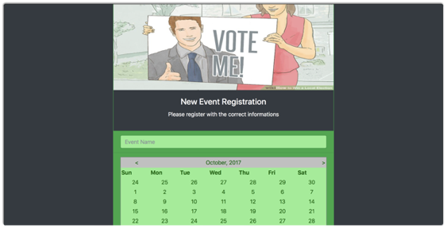
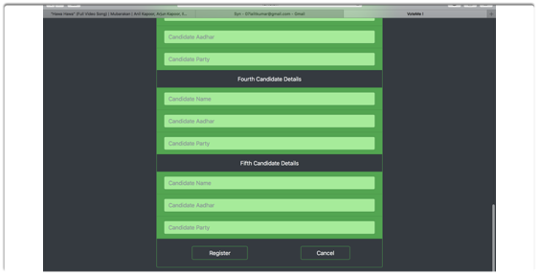
screen shots
3. Create New Voting Event

Slide 9
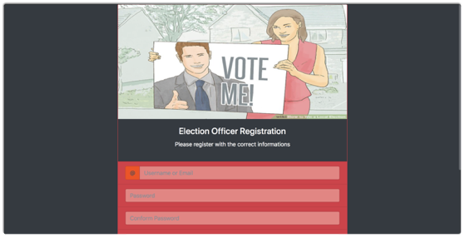
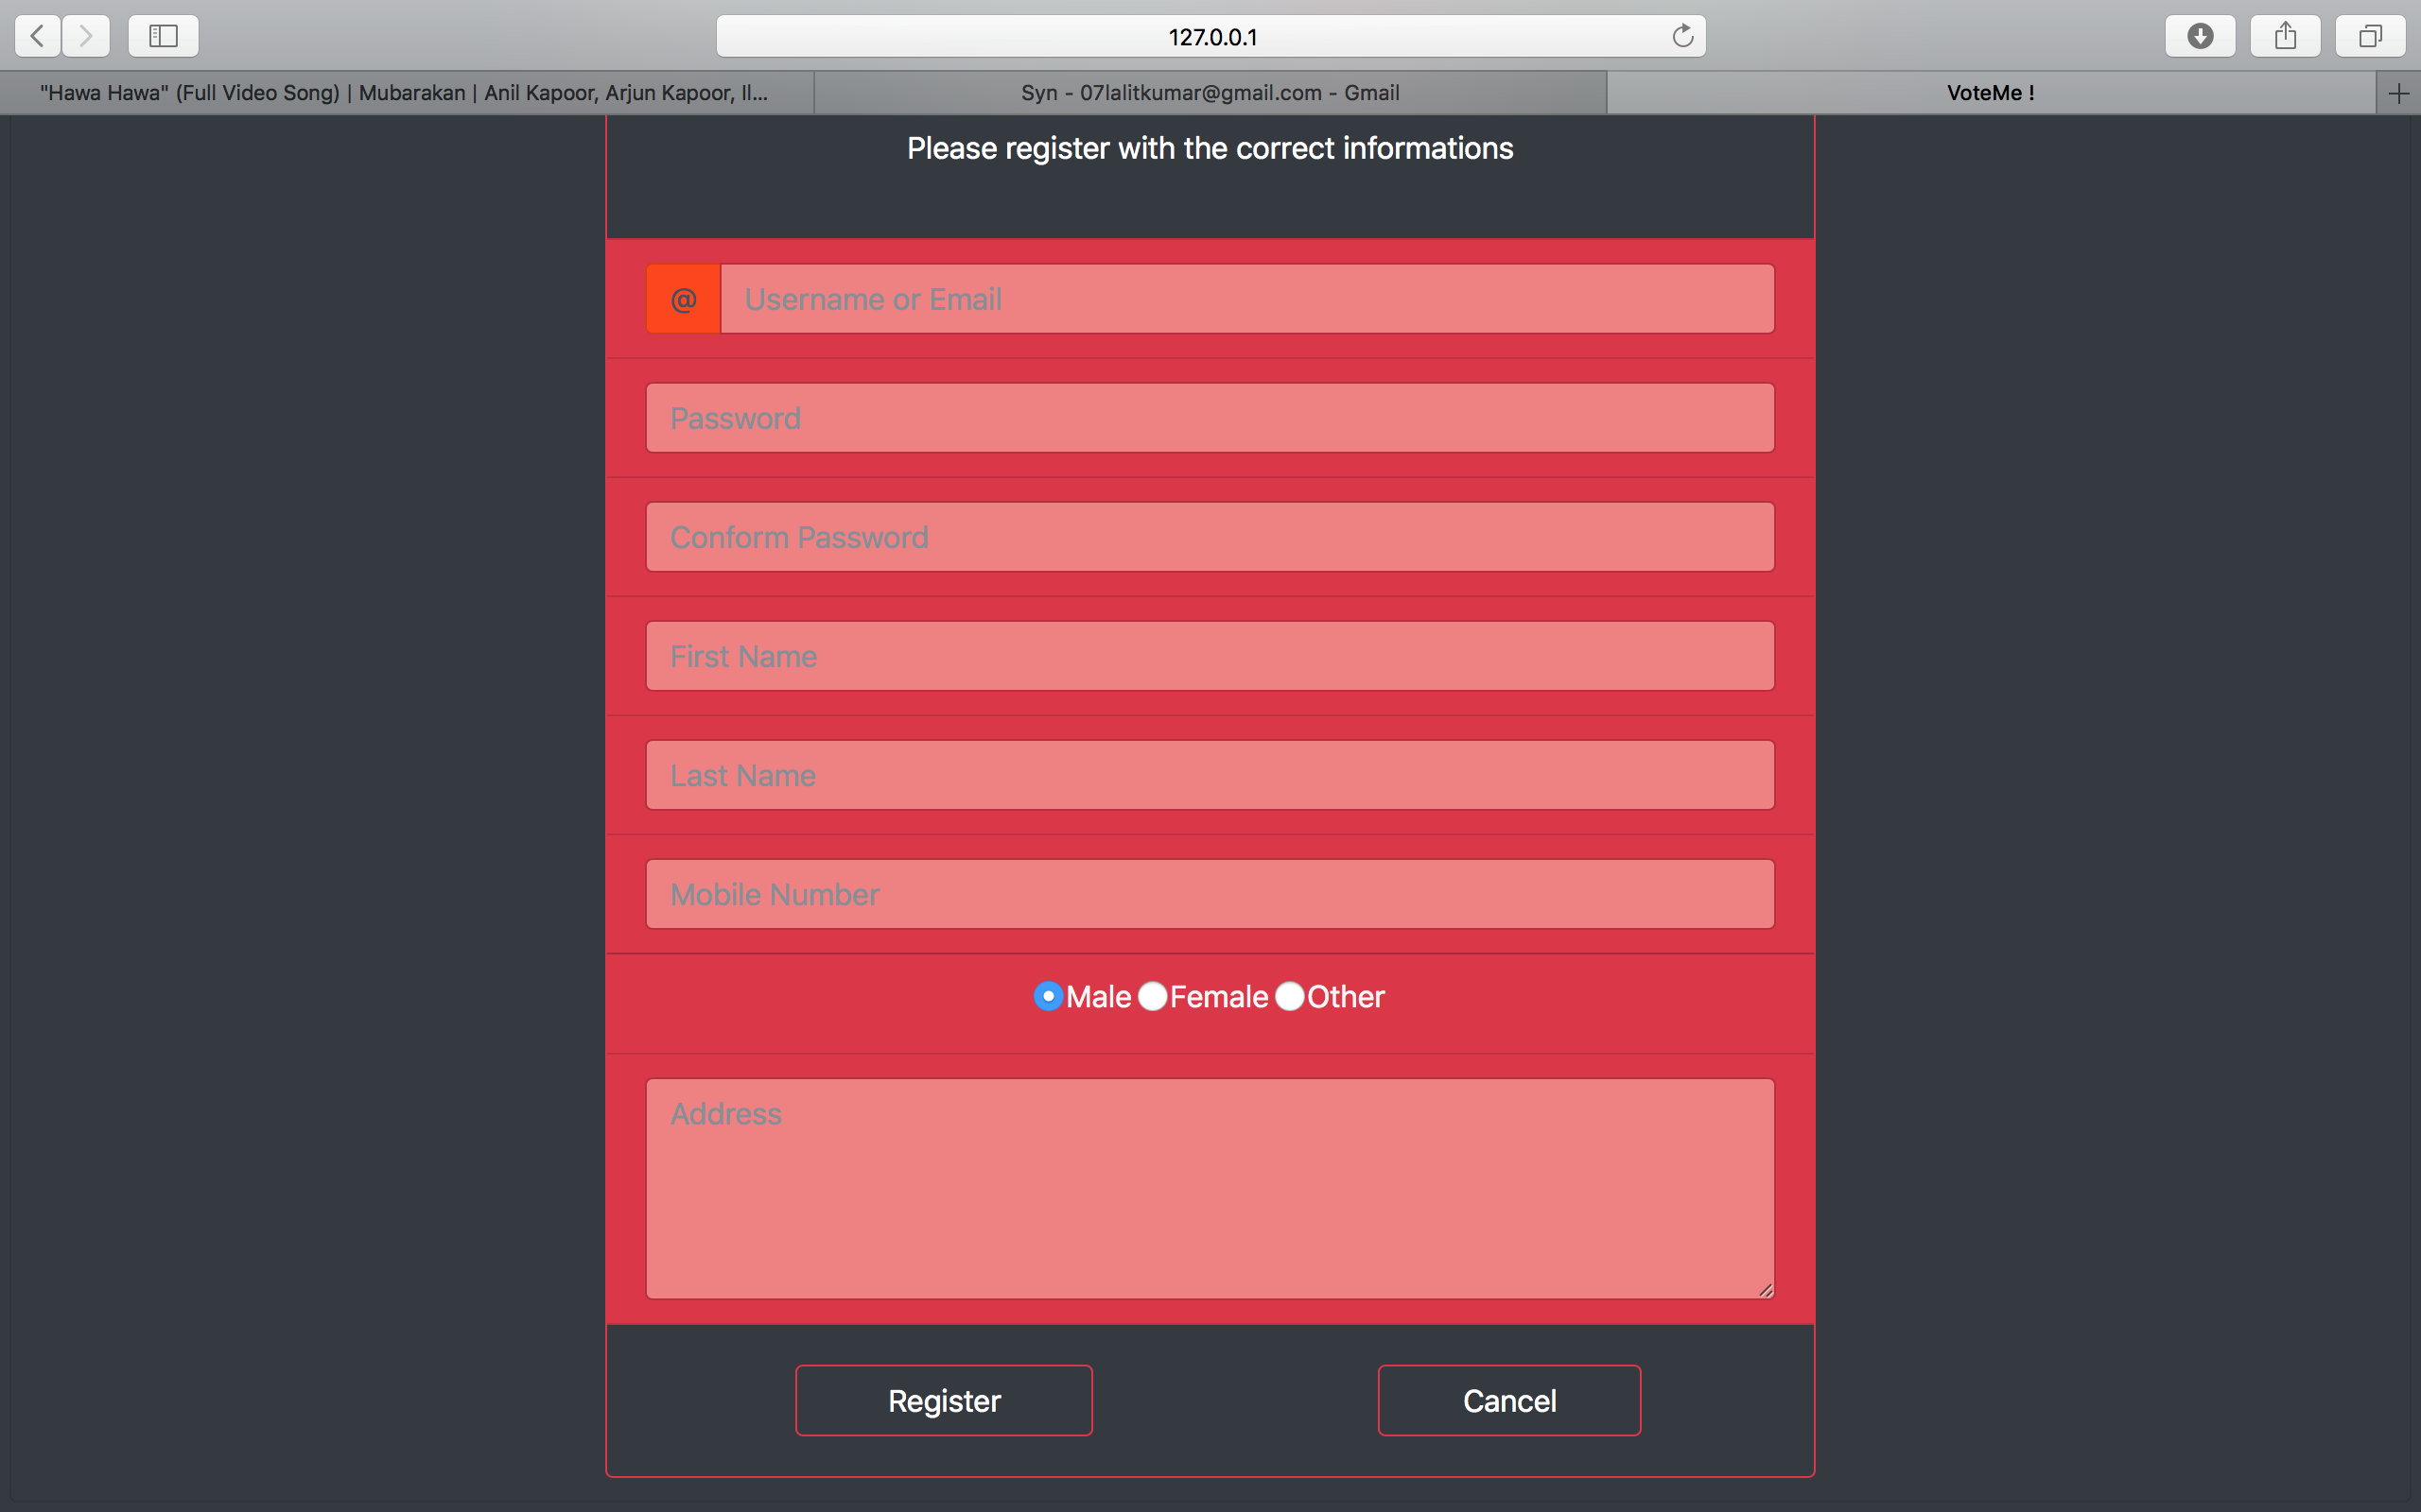
screen shots
4. Register New ELE. Officer

Slide 10
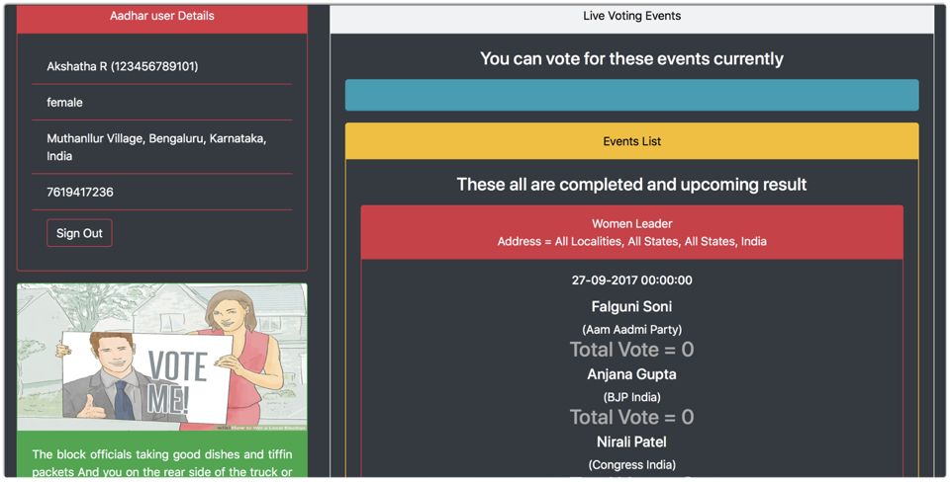
screen shots
5. User Page

Slide 11
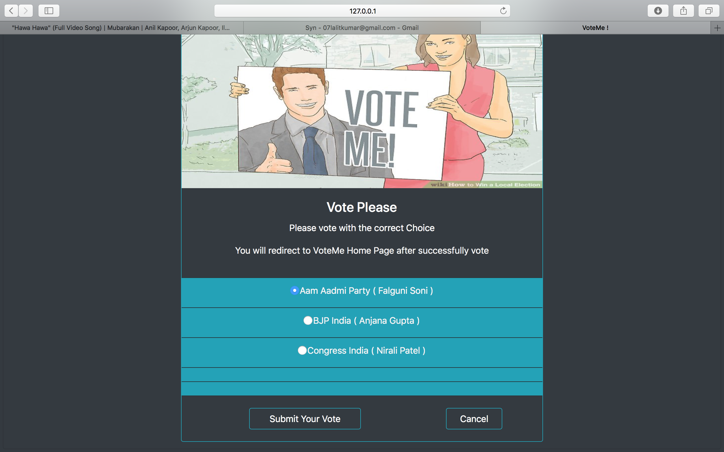
screen shots
5. Voting

Slide 12
Thank you !

